Slide 1
“disloyalty ‘must be crushed out’ of existence”: civil liberties in America during world war I
Authored by Dr. Michael S. Davis

Slide 2
The years 1917 and 1918 were especially problematic for American civil liberties.
State and local governments worked to suppress anti-war sentiments.
the Justice department and its bureau of investigation (BI) were transformed into America’s premier counter-subversive organization.
Patriotic-minded vigilantes enforced support for the war through threats and acts of violence.

Slide 3
America’s war experience laid the foundation for an expanded notion of individual freedom and expression.
Some Americans were mortified by the harshness of the attacks upon war dissenters.
They began placing a higher value on the right to petition the government.

Slide 4
The years 1917 and 1918 also witnessed Organizations that Fought violations of freedom of expression.
The NCLB (National civil liberties bureau) which, in 1920, became the ACLU (AMERICAN CIVIL LIBERTIES Union).

Slide 5
did the suppression of dissent begin with World War I?
No:
Since the creation of the constitution (1787), the federal government has engaged in some form of freedoms suppression.
These efforts though were limited in their scope.

Slide 6
1798:
The Alien and Sedition acts become law.
The United States was on the brink of war with France.
The federalist party authored the sedition act, which outlawed intentionally defamatory criticism of a “false, scandalous, and malicious” nature aimed at the federal government.
criticism of federalist policies was also considered traitorous.
A number of individuals were prosecuted for criticizing President John Adams.
Federalists also feared that immigrants were more sympathetic to the French, not to their friends in England.
Lastly, Immigrants tended to vote Democratic-Republican, not Federalist.

Slide 7
the federalist-controlled congress passed a series of laws that:
Raised the residency requirement for American citizenship from five to fourteen years.
Authorized the president to deport aliens, and permit their arrest, imprisonment, and deportation during wartime.
The sedition act made it a crime for citizens to “print, utter, or publish … any false, scandalous, and malicious writing” about the federal government.

Slide 8
1861:
President Abraham Lincoln suspends the writ of Habeas corpus.
The writ of habeas corpus is the right of a prisoner to challenge his detention.
Citing the threat posed by Confederate spies, president Abraham Lincoln suspends habeas corpus in the state of Maryland.
This allows suspected spies to be held indefinitely.

Slide 9
How did The Supreme Court React?
Chief Justice Roger B. Taney condemned the suspension of habeas corpus as unconstitutional, but the next year, Lincoln suspends habeas corpus for all states.
The supreme court later rules that the constitution permits only Congress to suspend habeas corpus (Article I, Section 9).
But, president Lincoln ignores the supreme Court’s decision.

Slide 10
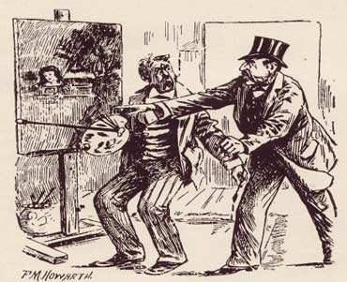
1873
In 1873, Congress passed legislation that became known as the “Comstock Law,” after its chief enforcer, Anthony Comstock of the post office department.
Comstock targeted for prosecution materials of a sexual nature, which in practice included literature critical of the institution of marriage.
The “Comstock Law” criminalized the dissemination of information about birth control, and it was used to prosecute Margaret Sanger and others who dissented from the government’s regulation of sexuality.
“That Fertile Imagination”, Life Magazine, 1888, Retrieved from http://case.edu/affil/skuyhistcontraception/online-2012/Comstock.html

Slide 11
Before World War I:
The most frequent abusers of the freedom of speech were local governments, which saw nothing wrong with arresting labor or radical speakers.
Speakers from the radical Industrial Workers of the World (IWW) were often detained as they tried to speak in public areas.
Their arrests were so common that the IWW embarked upon its “Free Speech fights” campaign in which their speakers deliberately courted arrest in an effort to demonstrate their lack of freedom.

Slide 12
Conclusions regarding The judicial tradition before 1917
Far less solicitous of first amendment rights than it would become in subsequent decades.
But, American involvement in the First World War fostered some of the most heinous violations of civil liberties in American History and, as we will see, at the same time, some of the first vigorous defenses of civil liberties.

Slide 13
Many people in the United States opposed America’s entrance into world war I
The Wilson Administration responded with an aggressive campaign of intimidation and coercion designed to silence dissent.
At the center of this effort were two pieces of wartime legislation:
  The Espionage Act of 1917
  The sedition act of 1918
  (Both gave the federal government the power to suppress and punish “disloyalty and subversion.”)

Slide 14
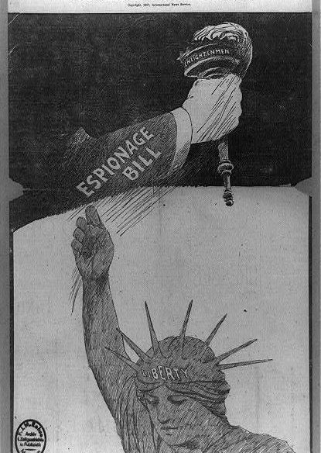
The Espionage Act of 1917
Allowed the postmaster general, Albert Sidney Burleson, to ban all “seditious” materials from the U.S. Mail.
Postmaster Burleson announced that “seditious” materials included anything that might “impugn the motives of the government and thus encourage insubordination,” or, anything that suggested that “the government is controlled by Wall Street or munitions manufacturers, or any other special interests.”
By definition, all publications of the Socialist party could be banned, and they were.
“Must liberty’s light go out?”, Winsor McCay, 1917, New York American Editorial, Retrieved from the Library of Congress, http://www.loc.gov/pictures/resource/cph.3b36807/

Slide 15
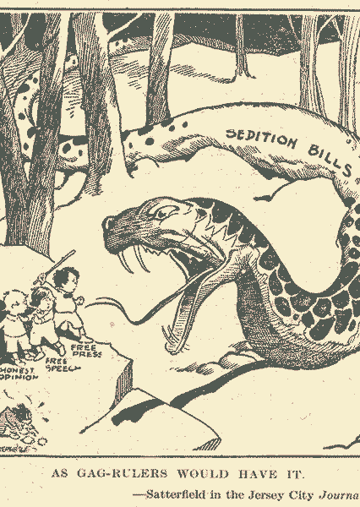
The Sedition act of 1918
Passed in 1918 to strengthen the provisions of the Espionage Act.
criminal offense to use “any disloyal, profane, scurrilous, or abusive language about the form of government of the United States or the Constitution of the United States, or the flag of the United States, or the uniform of the Army or Navy,” or any language that might bring those institutions “into contempt, scorn, … or disrepute.”
The Sedition act was particularly useful against radicals and labor unionists.

Slide 16
“You shall not criticize anything or anybody in the Government any longer or you shall go to jail”.
-Hiram Johnson, progressive Senator from California, describing the provisions of the Sedition Act

Slide 17
What Did the U.S. Supreme Court have to say about the Espionage and Sedition Acts?
In a series of important cases, the Supreme Court upheld the Espionage and Sedition acts.

Slide 18
Schenck v. united states (1919)
Charles T. Schenck, a Leader of the socialist party, as well as some other individuals, were convicted of attempting to obstruct the draft and cause insubordination in the armed services by printing and mailing anti-war flyers.
One side of the flyer began with “long live the constitution of the united states,” and it quoted the thirteenth amendment which bars slavery and involuntary servitude.

Slide 19
“[During ordinary times, the defendants would have been able to express these views. But] … when a nation is at war, many things that might be said in time of peace are such a hindrance to its effort that utterance will not be endured as long as men fight, and that no court could regard them as protected by any constitutional right”.
-Justice Oliver Wendell holmes jr., writing for the supreme court

Slide 20
For Oliver Wendell Holmes, Jr. the circumstances of this case mattered greatly:
“the most stringent protection of free speech would not protect a man in falsely shouting fire in a theatre and causing a panic… the question in every case is whether the words used are used in such circumstances and are of such a nature as to create a clear and present danger that they will bring about the substantive evils that congress had a right to prevent.”

Slide 21
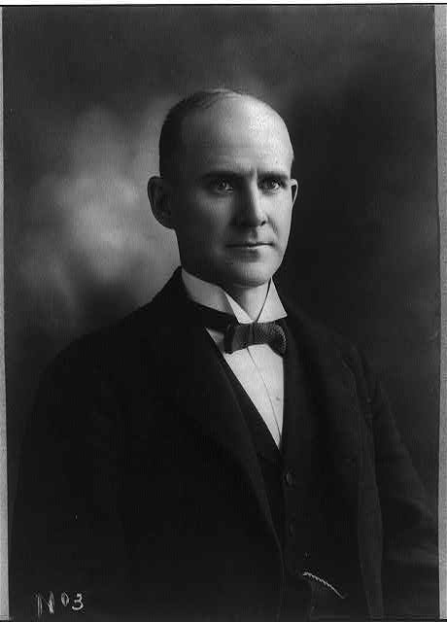
Debs v. united states
Oliver Wendell holmes, Jr. also wrote the majority opinion in this case, upholding the Sedition Act in the prosecution of labor leader Eugene v. debs.
Eugene V. Debs. , 1897. Photograph. Retrieved from the Library of Congress, https://www.loc.gov/item/2004671916/

Slide 22
After a summer of scholarly criticism of holmes’ opinions, this time, along with Louis Brandeis, he dissented. They dismissed the idea that the defendants in the abrams case attempted to distribute pamphlets that would realistically impede the American war effort.
Abrams v. united states (1919)

Slide 23
“When men have realized that time has upset many fighting faiths, they may come to believe even more the very foundations of their own conduct that the ultimate good desired is better reached by free trade in ideas – that the best test of truth is the power of the thought to get itself accepted in the competition of the market, and that truth is the only ground upon which their wishes safely can be carried out. That at any rate is the theory of our constitution.”
-Justice holmes
These cases have sometimes been viewed as the starting point for modern first amendment jurisprudence.

Slide 24
The APL and the suppression of civil liberties.
The state encouraged and reflected a widespread popular intolerance of dissent that at times became highly coercive.
In 1917, private citizens formed the American protective league (APL) to help the government in the task of maintaining loyalty.
The aPL received a ringing endorsement of Attorney General Thomas W. Gregory, who called it a “patriotic organization … assisting the heavily overworked federal authorities in keeping an eye on disloyal individuals and making reports on disloyal utterances.”
By the end of world war I, the APL had almost 250,000 members.

Slide 25
What were some of the activities of the APL?
Spying on neighbors.
Eavesdropping on suspicious conversations in bars and restaurants.
Intercepting and opening the mail and telegrams of people suspected of disloyalty.
Reporting to the proper authorities any evidence of disfavor with the American war effort.
Making extralegal arrests.
Organizing “Slacker Raids” against perceived resisters of the draft.

Slide 26
The APL was the largest of these types of organizations, but there was also:
The national security league
The American defense society
The boy spies of America (molded after the Boy Scouts of America)

Slide 27
Much of this repression was directed at:
Labor leaders
Radicals
Other dissidents
Immigrants
German immigrants

Slide 28
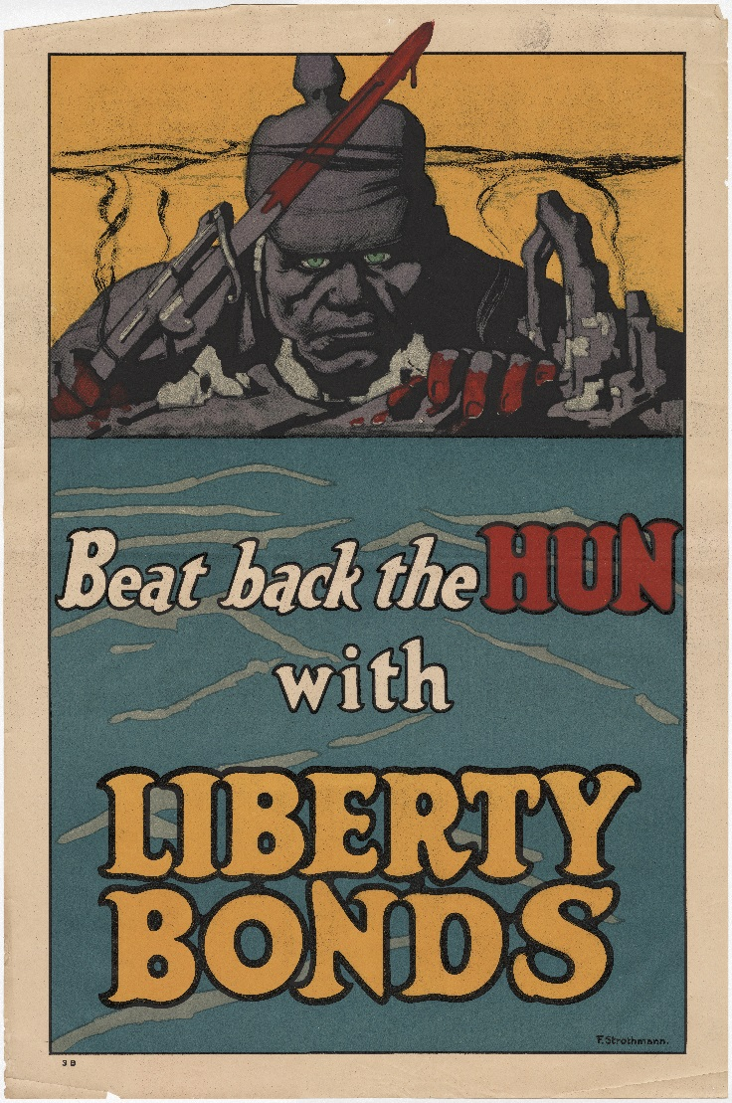
The repression fell particularly hard among German immigrants
Symphonies refused to perform classical music written by Bach and Beethoven.
Schools dropped German language classes.
The California board of education banned the teaching of German in California schools, calling it “a language that disseminates the ideals of autocracy, brutality, and hatred.”
“Beat Back the Hun with Liberty Bonds, Poster, 1920.1.10a” (Kansas City, MO: National WWI Museum and Memorial).

Slide 29
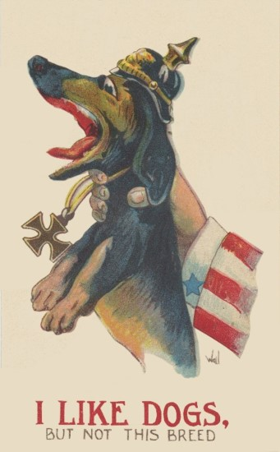
“Sauerkraut” was renamed “liberty cabbage.”
“German measles” were renamed “Liberty Measles.”
Dachshunds became “liberty pups.”
“Hamburgers” became “Liberty Sausage.”
“I like dogs, but not this breed, Poster, XC2006.09.5.4” (Miami Beach, FL: The Wolfsonian).

Slide 30
German books and china were destroyed.
German folksongs (“Oh Tannenbaum”) were torn from children’s songbooks.
German street names were changed.
Those who were considered to be pro-German were forced to quit their jobs, change their names, and in a few cases, endure physical violence.

Slide 31
Libraries removed German books from their shelves.
German university faculty were fired.
German musicians were let go.
People with German names were barred from serving in the Red Cross (rumors abounded of plots by German Americans to place grounded glass in bandages intended for the front.)

Slide 32
Did the end of the first World War in 1918 bring an end to widespread intolerance in the United states?
No:
the war made things worse by ushering in a new period in American History called the “Red Scare.”

Slide 33
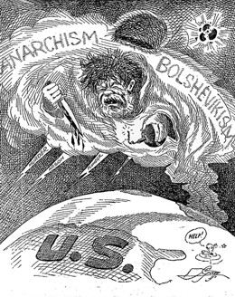
The Red Scare
response to the Bolshevik (communist) revolution in Russia and the tremendous fear that event created throughout the capitalist world.
It was also a product of the great instability of postwar America, which many middle-class people believed to be started by revolutionaries.
There was:
Widespread labor unrest
Racial conflicts in America’s cities
Economic turbulence
A small but frightening wave of terrorist acts by radicals
“The Cloud”, The Atlanta Constitution, 1919, Retrieved from http://americainclass.org/sources/becomingmodern/divisions/text8/text8.htm

Slide 34
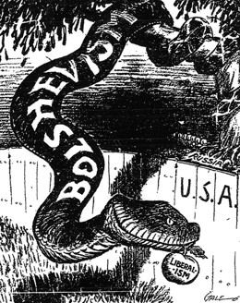
the “Red Scare” was, above all, a result of the deliberate strategies of ambitious politicians, who saw the campaign against the “Reds,” as a stepping stone for their political careers.
The Justice Department, under Attorney general A. Mitchell Palmer, who hoped to be sitting in the “Oval office” in 1921, was the leading instigator of the “red scare.”
“The Big Red Apple”, Los Angeles Times, 1923, Retrieved from http://americainclass.org/sources/becomingmodern/divisions/text8/text8.htm

Slide 35
The “Palmer Raids”
A series of mail bombings, including an attempted bombing of Palmer’s own home, helped legitimize the major campaign against radicals. (he was already planning these raids).
he officially launched these ‘raids” on New Year’s Day 1920.
Orchestrated by a young j. Edgar Hoover, the “Palmer Raids” produced 6,000 arrests, amid enormous publicity.
Most of those who were detained were not radicals at all.
even the relatively few genuine radicals who were rounded up, were never shown to have violated any laws.
Most were eventually released, although many Remained in custody for weeks and even months without facing formal charges.
Additionally, many Did not have access to legal representation nor to their families.

Slide 36
America’s experience in World War I had two especially important consequences:
The war experience helped to transform the Justice Department and its Bureau of Investigation (BI) into America’s premier countersubversive bureaucracy. In the postwar “red Scare” of 1919-1920, the Department and BI rounded up and secured the deportation of allegedly radical unnaturalized immigrants, and in subsequent years, the BI would monitor and harass individuals and groups it deemed subversive.
The NCLB (which, in 1920, became the American Civil Liberties Union, or ACLU), helped draw attention to the excesses of the postwar deportation campaign, and would go on to play a leading role in contesting future governmental infringements of civil liberties.

